Slide 1
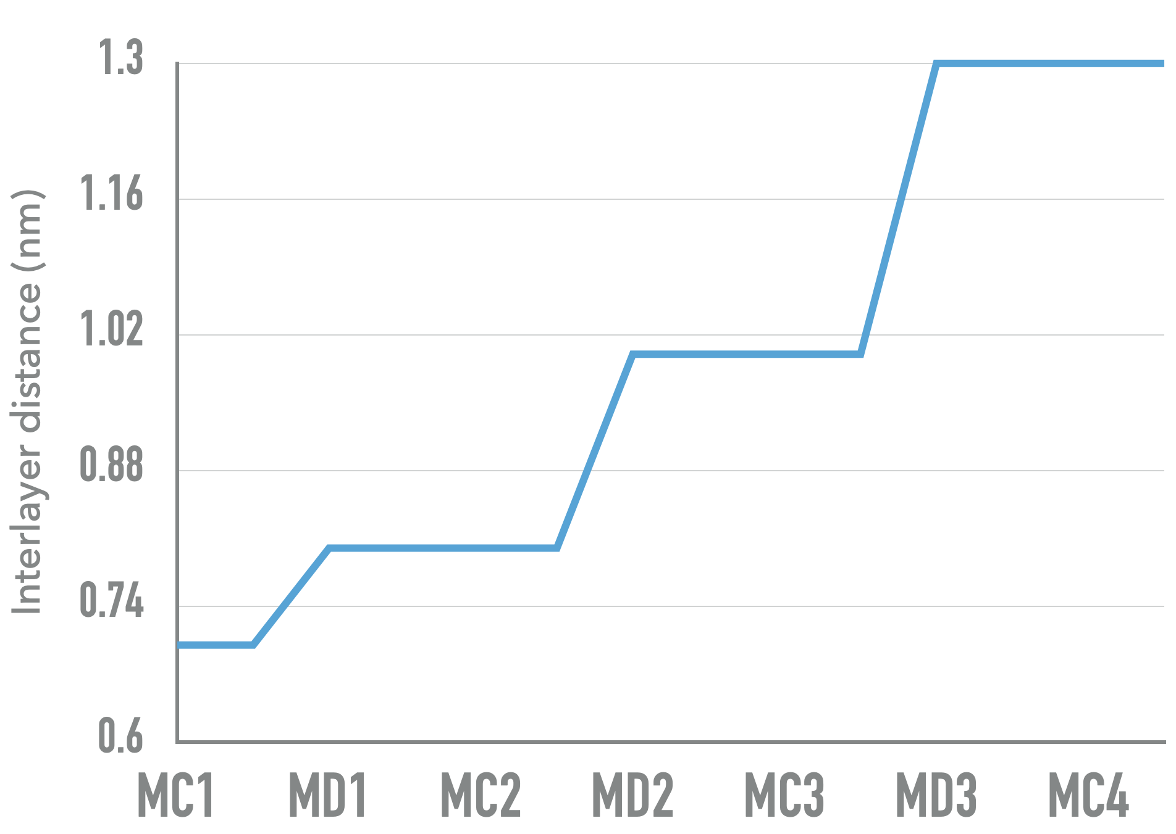

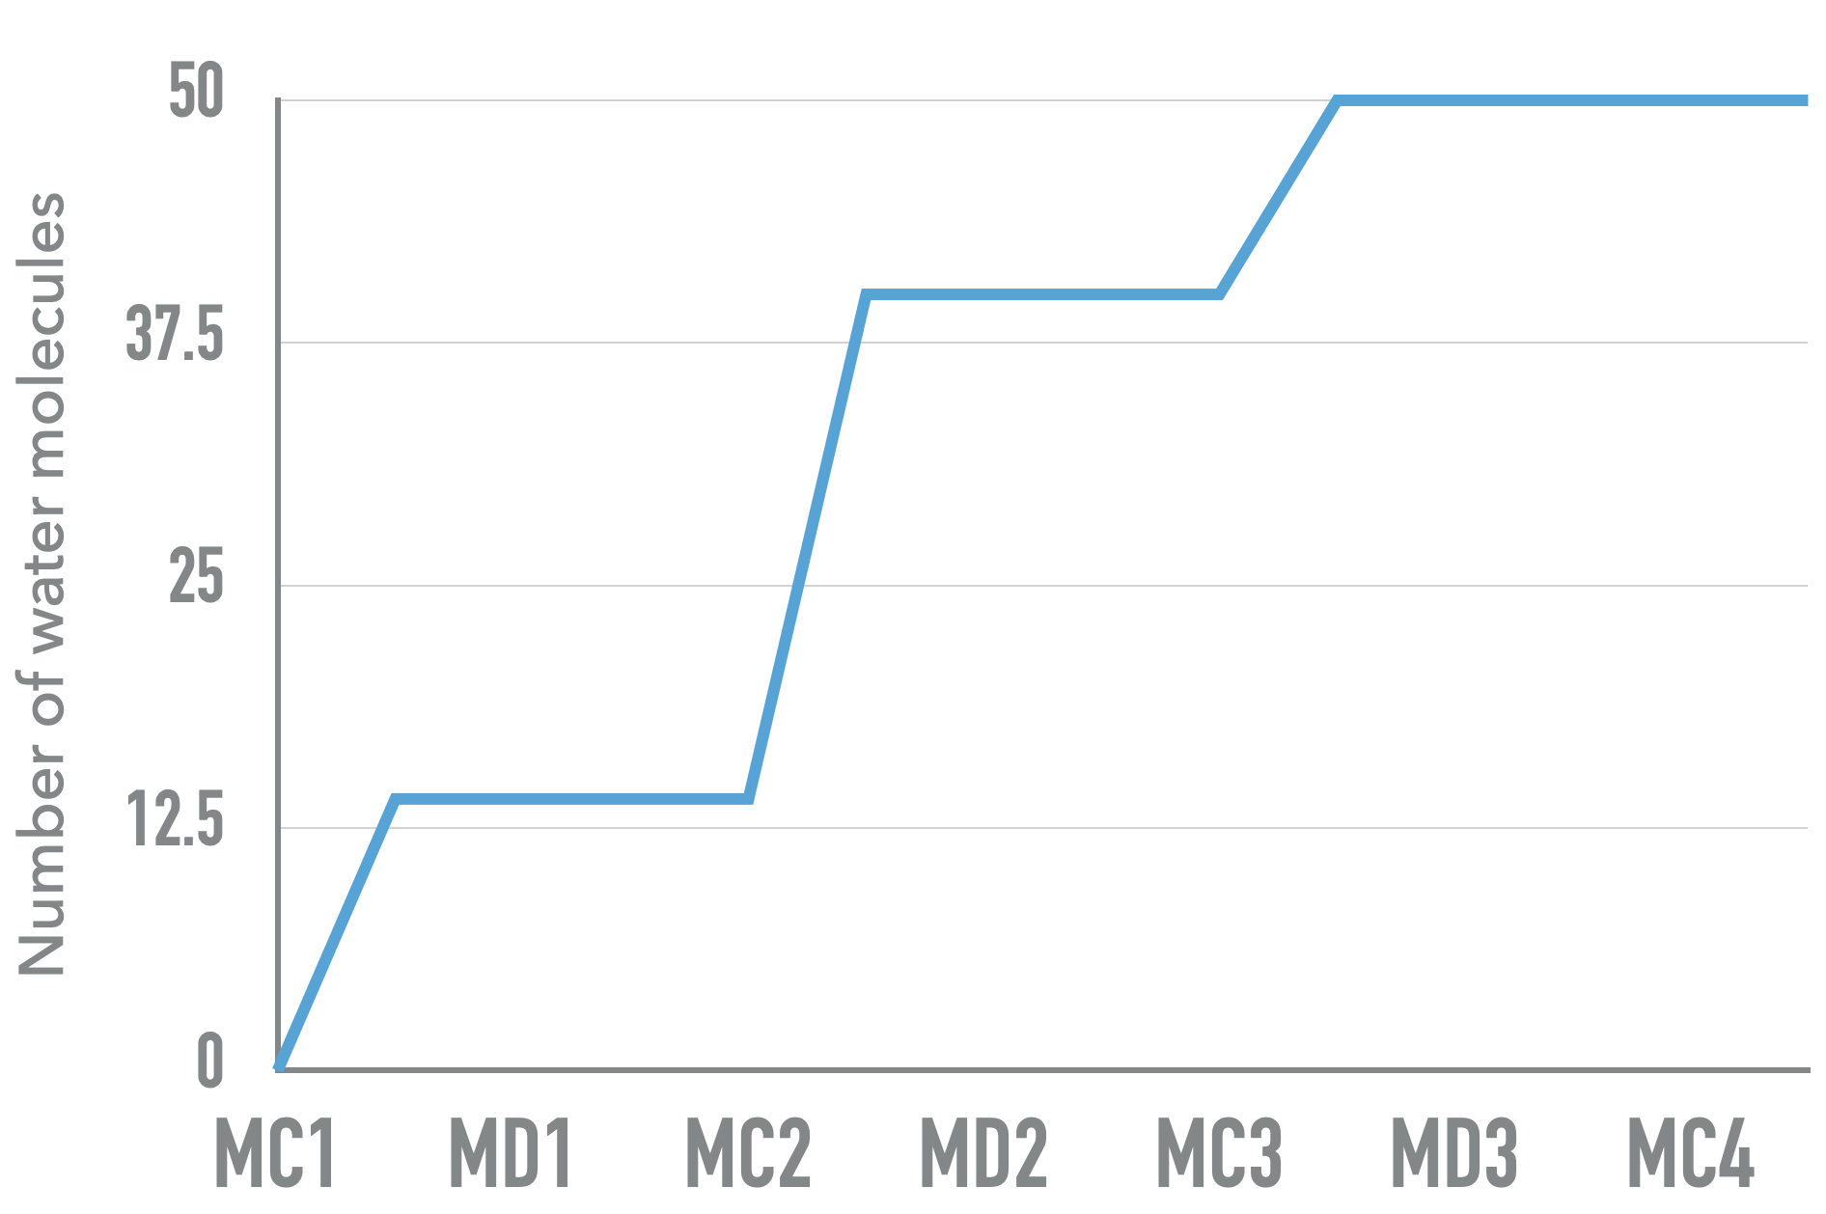
Methodology sorption relaxation cycle (SRC)
Water adsorption in a rigid and fixed interlayer spacing Graphene Oxide membrane (GOM) is simulated in Grand Canonical Monte Carlo (GCMC) simulation
The number of water molecules adsorbed is expected to increase during the adsorption process
The GOM and adsorbed water is then transferred to Molecular Dynamics (MD) simulation under isobaric-isothermal (NPT) ensemble to relax the membrane and allow it to swell due to vertical internal pressure from adsorbed water molecules
The size of interlayer spacing of GOM is expected to increase (swell)
The GOM with new interlayer spacing size is return to GCMC simulation for further water adsorption (New cycle)
Figure below shows the diagram of increase in number of water adsorbed and interlayer spacing from GCMC and MD simulation respectively (Yellow arrow indicates one cycle)
The cycle is repeated until the number of water adsorbed and size of interlayer spacing stops evolving

